Slide 1


SAP UI5 & FIORI with OData TRAINING
Anubhav Oberoy
Day – 7

Slide 2

Agenda – Day 7
Introduction to manifest.json
Understanding the structure of manifest.json
Introduction to List Control in UI5
Types of List Control
Binding of List control
Understanding the List Modes
Understanding how to search data using Search Field
Introduction to the Data Filtering
Adding toolbar in the application.
Showing a Message Box.
Introduction to Worklist Fiori Application

Slide 3
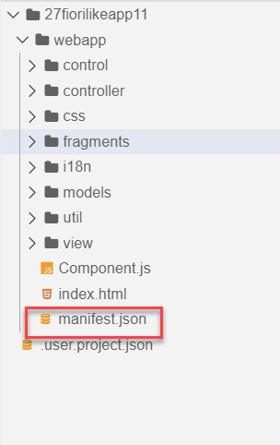
Concept of manifest.json in UI5
manifest.json is also knows as application descriptor file. It contains all the configuration for our app centrally.
Some attributes in the descriptor are just for information purposes, such as the minimum OpenUI5 version (minUI5version), others help external components (for example the SAP Fiori launchpad (FLP)) to integrate the application correctly, but most of the attributes are actually used to configure specific aspects of the app that are needed frequently.
It is written in JavaScript Object Notation (JSON) format.
We recommend that you use the manifest.json file to configure the app settings and put
all important information needed to run the app in there. Using this approach means
you need to write less application code, and you can already access the information
before the app is instantiated.
Everything which is needed for an app to start, load, move, run, configure,
requires is inside manifest.json.

Slide 4
Three Sections of manifest.json
sap.ui5 contains different components
rootView, dependencies, contentDensities, models, routing etc.
sap.ui5
sap.app contains idtype, i18n, applicationVersion, title, description, dataSources.
sap.app
sap.ui contains technology, icons, deviceTypes, supportedThemes
sap.ui

Slide 5
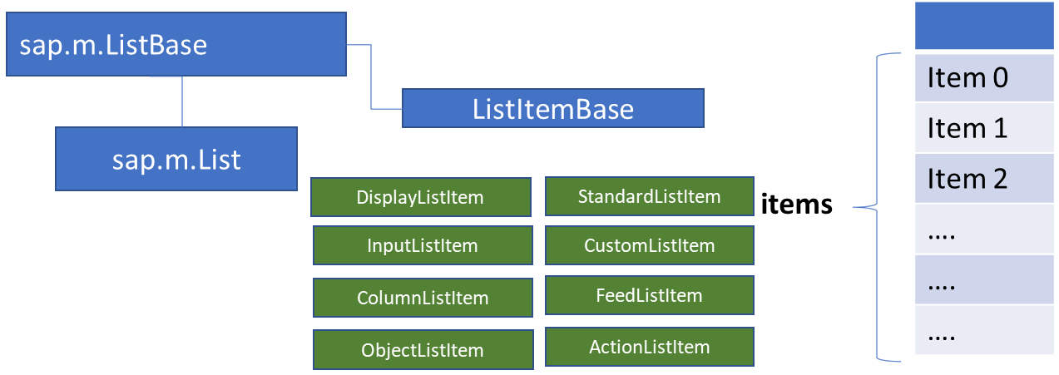
List Control
The list contains various list items. These items can be of various types depending on the use case and on the content they have. SAPUI5 already provides the most common list items in SAP Fiori in the form of controls, although custom list items can also be created if necessary.
Reference: https://sapui5.hana.ondemand.com/#/entity/sap.m.List
A List control is a single column table with multiple items inside. We will have a list header and items as aggregation.

Slide 6

Exercise
In this Exercise we will add some commonly used list controls to the view. We will also see how to use the samples given in the UI5 SDK.
Exercise code/resource:-
View1.view.xml

Slide 7
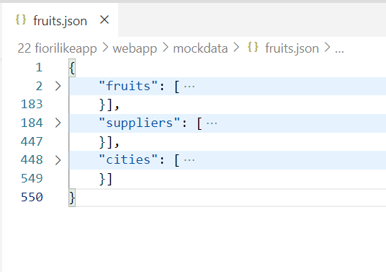
Binding List Items
Now we will bind the list form some demo data. But before we start, we need some demo data in json file. The data is provided in exercise as fruits.json.
It contains 3 entity sets:
fruits – name, color, type (neutral, citrus, alkaline),price, currency, unit, availability (available, discontinued, out of stock), season, photo (url from google) - 20
cities – name, state, famousFor, population, lat, lng -10
supplier – name, contactPerson, contactNo, sinceWhen, city, speciality :[“name of fruits”] -10

Slide 8
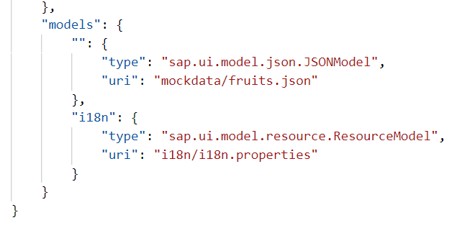
Model Instantiation
The app configures several data models that are used throughout the app to update the views or to store additional configuration options.
The service model and the resource bundle are instantiated automatically by the app’s component during startup and described in the first section. The local view models and helper models such as the device model are set up as JSON models and described in the second section.
Automatic Model Instantiation
The templates instantiate the service and resource model automatically using the following configuration entries in the descriptor. When the component of the app is initialized, these models will be made available under the configured name throughout the app.
An external service is defined in the dataSources section of the sap.app namespace. In the example shown below, we configure an OData with protocol version 2.0 and the alias "mainService" in the manifest.json file:

Slide 9
List Modes
The mode property defines the appearance of the left area of a list item.
Lists have properties and events and they contain list items that inherit from sap.m.ListItemBase, which provides navigation, selection and event features.
Delete
SingleSelect
01
04
only one list item can be deleted via provided delete button
Right-positioned single selection mode (only one list item can be selected).
01
04
MultiSelect
You can edit this text
SingleSelectLeft
02
05
02
more than one list item can be selected
05
Left-positioned single selection mode (only one list item can be selected).
03
06
None
03
06
SingleSelectMaster
no selection
Selected item is highlighted but no selection control is visible (only one list item can be selected).

Slide 10

Exercise
In this exercise we will Instantiate our model in Manifest.json and then bind the newly created model with the List in the view.
Along with that we will also use some formatter in the list.
Exercise code/resource:
View1.view.xml
manifest.json
fruits.json
formatter.js

Slide 11
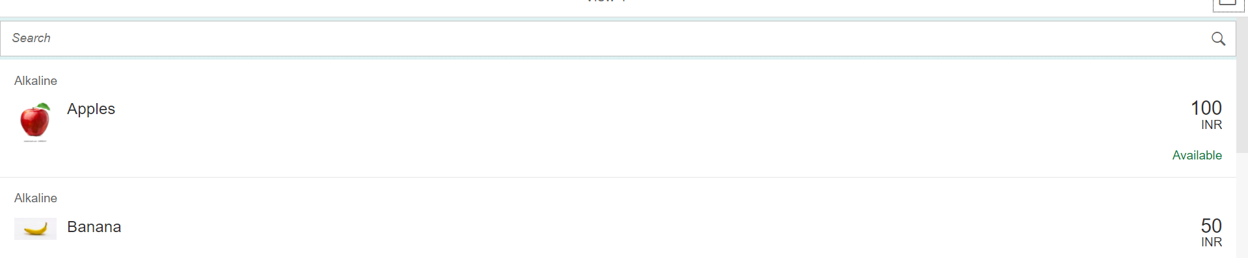
Exercise - Using Search Fields to Filter Data
Nowadays we come across many web pages that provide data in the form of lists or tables. These lists are enabled with search functionality, i.e., as the user types in into the search field and press enter then the data in the list is filtered according to the value in search field.
In this exercise we will implement the search functionality in our application to filter data in fruits list.
Exercise code/resource:
View1.view.xml
View1.controller.js

Slide 12
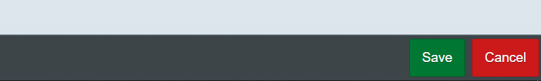
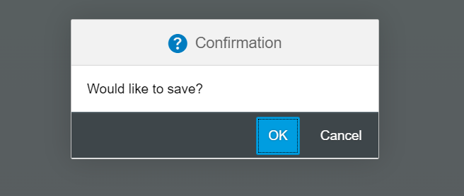
Exercise – Toolbar & Message Box
Toolbar:- A toolbar is a set of icons or buttons that are part of a software program's interface or an open window.
Toolbars have items such as Back and Forward buttons, a Home button, and an address field.
MessageBox: - The message box (sap.m.MessageBox) is a special dialog that allows you to display messages to the user. Compared to the message popover (sap.m.MessagePopover), you can use the message box to display messages that are not related to a field on the UI, such as technical errors.
In this exercise we will add a footer toolbar on the View2, in that toolbar we will also add to buttons and on click of that buttons we will open a MessageBox.
Exercise Code/Resource:
View2.view.xml
View2.controller.js
Header Toolbar
Footer Toolbar
Message Box

Slide 13
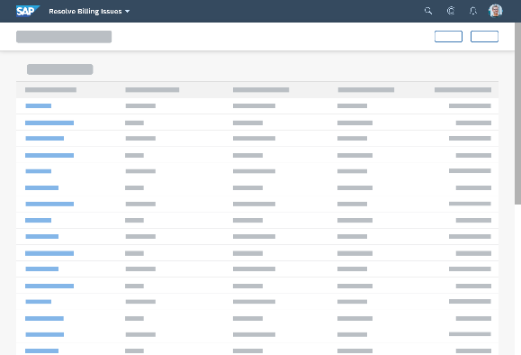
Introduction to Worklist Application
A worklist displays a collection of items a user needs to process. Working through the list usually involves reviewing details of the items and taking action. In most cases, the user has to either complete a work item or delegate it.
When to use:
Users have numerous work items and need to decide which ones to process first.
You want to give users a direct entry point for taking action on work items.
Users need to work with multiple views of the same content (for example, items that are “Open”, “In Process”, or “Completed”). You want to offer tabs for switching between views.
Detail View
List Page

Slide 14

Exercise
Now we will make over application a worklist application.
When we select a fruit in the list on the view1 the details of that fruit will be visible on the View2.
Exercise code/resources:
View1.view.xml
View1.controller.js
View2.view.xml

Slide 15

End of Day 7

Slide 16

Questions

Slide 17

Anubhav Oberoy

Slide 18


We’re committed to empower you to be
Most Desirable Resource
through powerful training solutions.
We build the workforce of the future.
250+
Corporate Clients
30,000+
Learners Trained
25000+
Learners Placed
FREE WEBINARS
Sign up for free webinars with industry experts every fortnight!
Enroll Now!
Contact us today!
https://anubhavtrainings.com/

Slide 19




More from AnubhavTrainings.com

Slide 20
Title
Content

